Slide 1
WGS Customized QC Pipeline
Xin Li
Oct 01, 2020

Slide 2
Brief Introduction
Background
Purpose
Workflow
Key Events
Current running status

Slide 3
Background
CGR and USU (Uniformed Services University of the Health Sciences)
CGR ask USU to generate a bunch of sequencing data for COVID 19 research studies.
HiSeq
USU will upload raw fastq file into the network storage system in biowulf.
We have no idea how they organize data until we see their data
USU want to know the quality of their sequencing data
Primary pipeline
Used to generate QC report for our in-house CGR raw data
bcl signal
Very restrict to fixed data structure (e.g. in-house data, LIMS)

Slide 4
Purpose (WGS Customized QC pipeline)
Provide QC report to USU
Generate the similar QC report as primary pipeline
No need bcl2fastq and trimming
Start from alignment
Run in biowulf
Handle the non-standard raw fastq files (compared with the data generated by CGR)
Maximize using the existing calculation code in primary pipeline
Fully automatic
Dynamic adjust the computing resources used in HPC

Slide 5
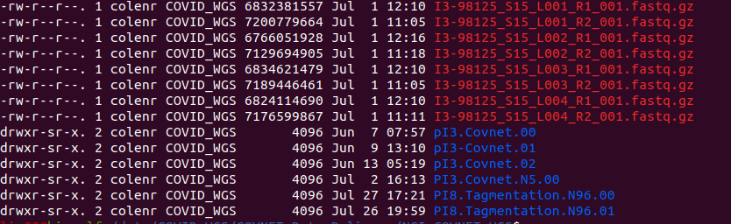
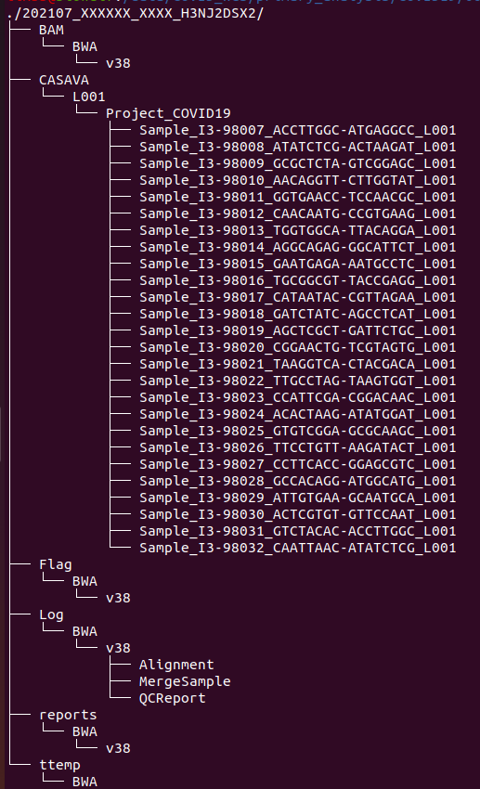
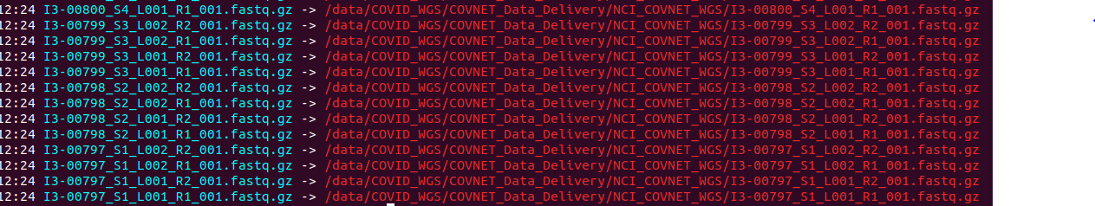
High-level workflow
Step 1

Slide 6
High-level workflow
Step 2

Slide 7
High-level workflow
Step 3
Additional Step
Move finished flowcell from network storage space to object storage system (s3)

Slide 8
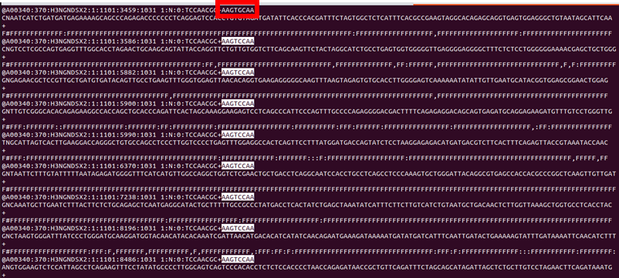
Key Events
Merge sample
Different Lanes
Delete the merged fastq on time
Get correct barcode

Slide 9
Key Events
Storage issue
Raw data size
Storage limitation in network file system
Speed limitation in object storage system
Data from USU
Maximum storage required for each sample
NIH policy

Slide 10
Current running status
Keep struggling with the issue of network storage space
Github
https://github.com/NCI-CGR/IlluminaSequencingAnalysis/tree/main/CustomizedQC

